Slide 1
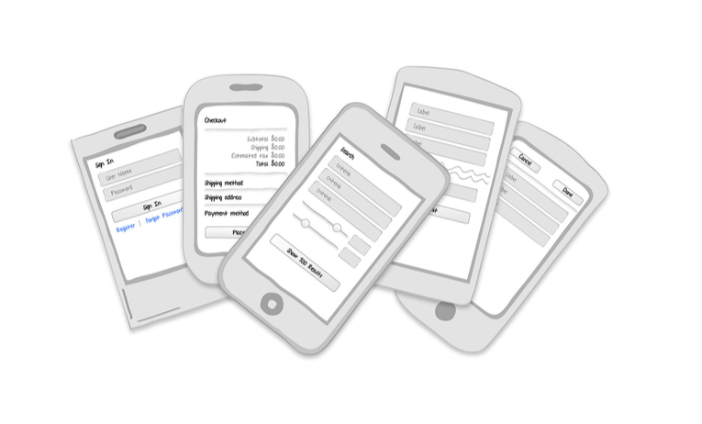
Forms

Slide 2
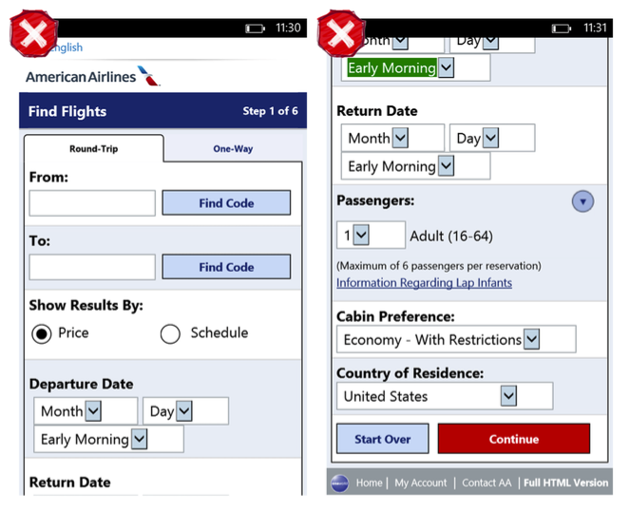
Notes:
Sometimes we succeed, but often we don’t . Form abandonment (users who fail to complete and submit forms before giving up) is an enor- mous and costly problem . But compared to mobile, the Web is pretty forgiving, because mobile forms—rendered on devices that have small screen sizes and restricted user input—give you, the designer, virtu- ally no leeway for bad design.
As a complement to these resources, the form design patterns that fol- low will help you build apps with forms that work for your users . They include:
Sign In
Registration
RegistrationwithPersonalization
Checkout
Calculator
SearchForm
Multi-StepForm
LongForm

Slide 3
Sign In
Sign In forms should require a minimal number of inputs: username, password, command button, password help, and an option to register . Some applications do this in a single screen, like Remember the Milk and Groupon.
Notes:
As a complement to these resources, the form design patterns that fol- low will help you build apps with forms that work for your users . They include:
Sign In
Registration
RegistrationwithPersonalization
Checkout
Calculator
SearchForm
Multi-StepForm
LongForm

Slide 4
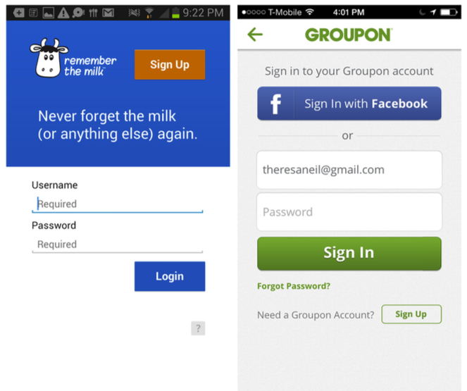

Slide 5
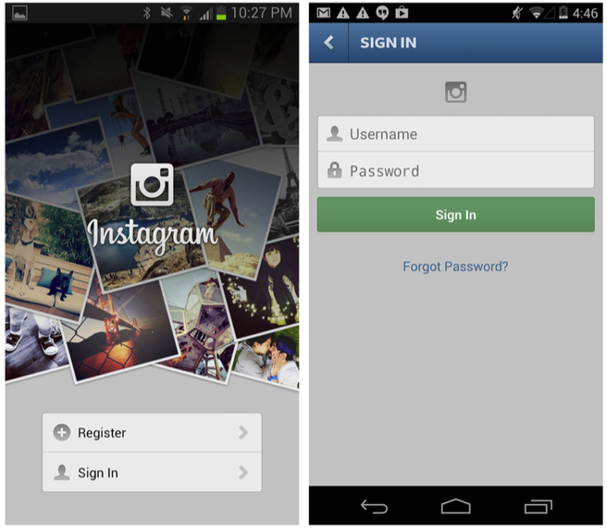
Notes:
Other apps, like Instagram, present the Sign In and Register options up front, then take the user to the appropriate form . You should auto- focus on the first form field, saving the user an extra tap to open the keyboard .

Slide 6
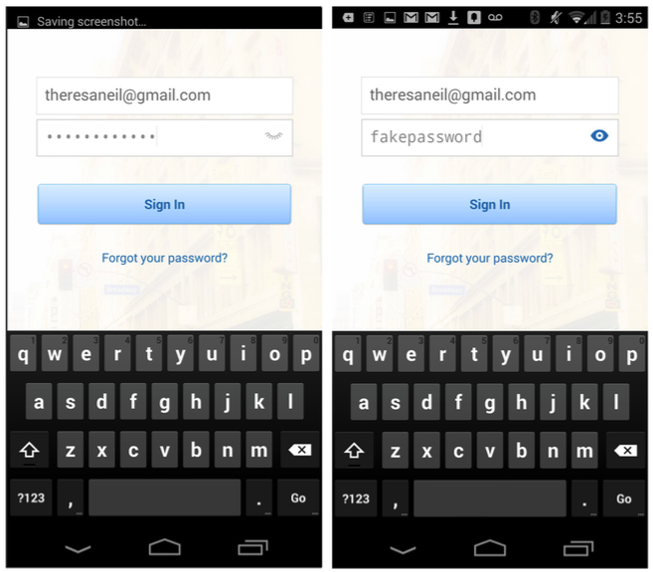
Notes:
The Sign In form itself should use a new technique that has substantial support from usability testing and live usage: the unmasked pass- word field . As in LinkedIn, show the password unmasked and/or offer the option to mask it . The open and close icon is common, or just the words Hide/Show (see the Polar example in the section “Registration” later in this chapter).

Slide 7
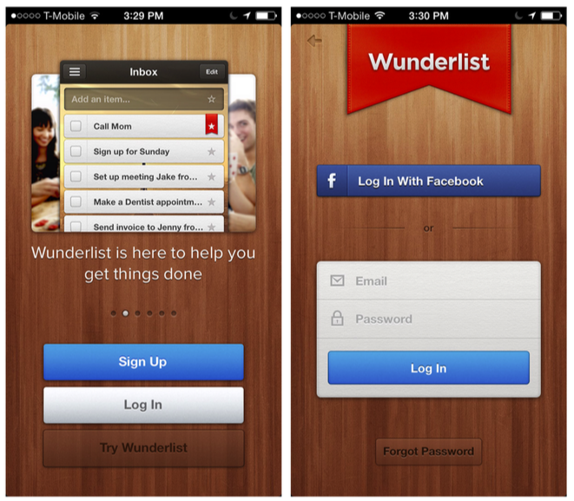
Notes:
Tabs are another viable option for presenting these two options while keeping navigation to a minimum, as shown with Foodspotting and SigFig.
Wunderlist for iOS: Sign Up and Log In are persistent throughout tour

Slide 8
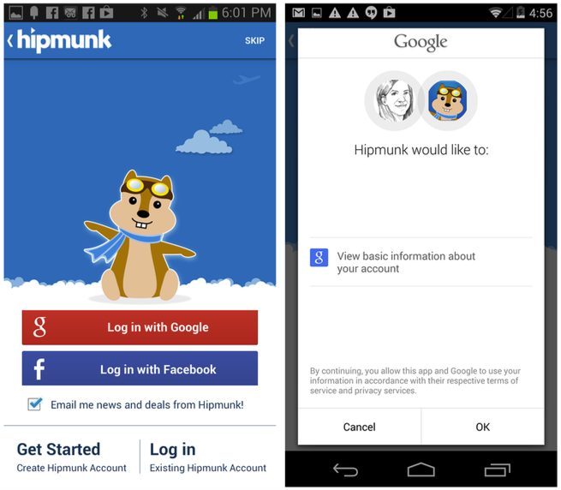
Notes:
Any of these patterns can also include a Social Sign In path, not to be confused with Social Sign Up, which we’ll cover in the Registration pattern . Social Sign In will take the user through the social network of his choice to gain access to the application.
Another Sign In option gaining popularity with the finance indus- try is to forgo the username field and just require a password . The user’s identity can be authenticated when the application is installed . Users are then only prompted for a password to access sensitive data . Requiring a mobile PIN as a password serves the same purpose, as shown in the examples from Frost Bank and Personal Capital .
http://code.tutsplus.com/tutorials/how-to-authenticate-users-with-facebook-connect--net-12302

Slide 9
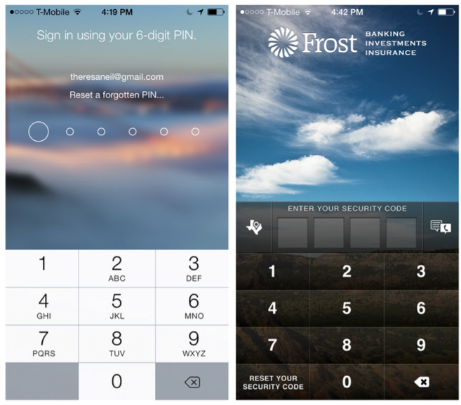
Notes:
Another Sign In option gaining popularity with the finance indus- try is to forgo the username field and just require a password . The user’s identity can be authenticated when the application is installed . Users are then only prompted for a password to access sensitive data . Requiring a mobile PIN as a password serves the same purpose, as shown in the examples from Frost Bank and Personal Capital .

Slide 10
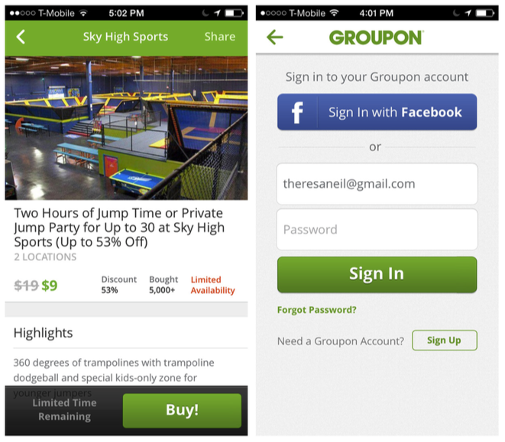
Notes:
In most of the examples we’ve seen so far, the Sign In form is pre- sented when the app is launched . But there are many cases where it’s preferable to allow the user to start using the application without hav- ing to sign in or register.
You can happily explore Groupon and Etsy unauthenticated, until it is time to buy an item or save a favorite (authentication could also be required to share, add an item to your wish list, add a comment, etc .) .
Why should you let folks shop without signing in or registering? Jared Spool explains it in his article “The $300 Million Button” (http://www.uie.com/articles/three_hund_million_button) . And if you need further convincing, take a look at the “Chapter Extra” by Greg Nudelman in Chapter 11.

Slide 11
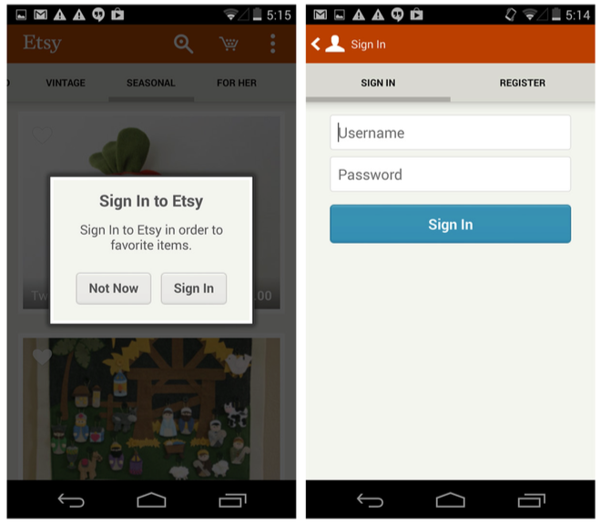

Slide 12
Registration
Businesses love customer data, so they often try to get as much of it as possible at user registration . But Registration forms should have a minimal number of inputs.
Since every additional form field demonstrably lowers Registration form conversion, UX consultant and author Chui Chui Tan recommends ruthlessly editing “elements which do not carry important functions .”

Slide 13
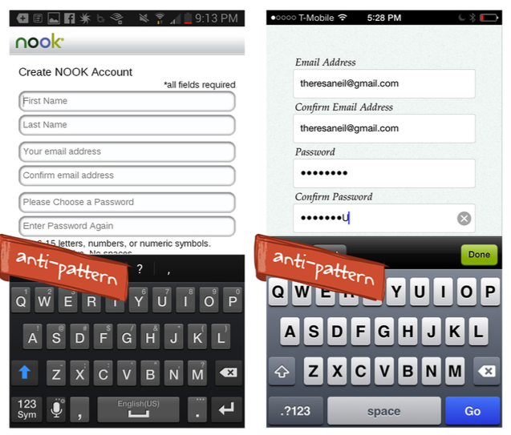
Notes:
One easy target has been validated by a lot of user testing: eliminating the redundant Confirm Email and Confirm Password fields found in apps such as NOOK and LearnVest.

Slide 14
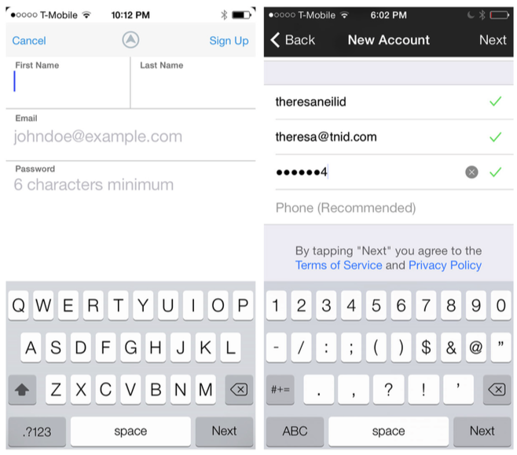

Slide 15
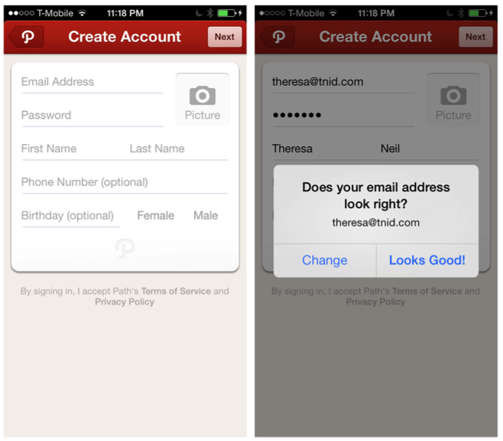
Notes:
Can’t live without email confirmation? Path’s Registration form is a bit longer, but it clearly marks the optional fields, and instead of asking for the email twice, it prompts users to double-check it.
Since this may be the first form you design for your application, establish a labeling convention that is easy to read . Polar, the fun polling app from form guru Luke Wroblewski provides a good example. Note that each field also has inline feedback and the password field has a Hide/Show option, which further makes redundant password entry unnecessary.

Slide 16
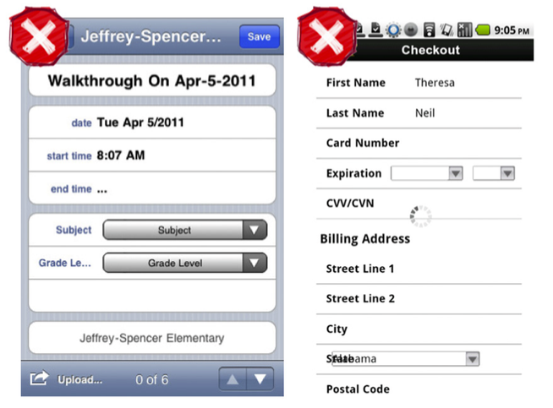
Notes:
horizontal labels can end up truncated or overlapped

Slide 17
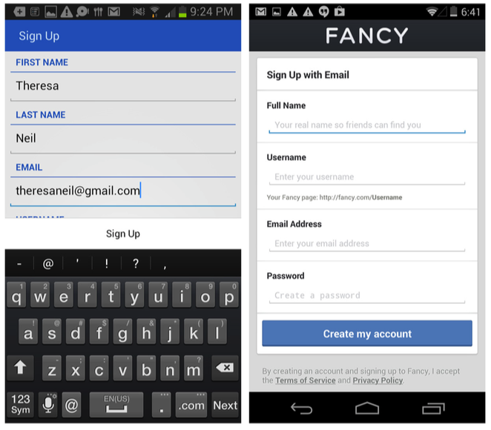
Notes:
Remember The Milk and Fancy for Android: vertically aligned labels often work better

Slide 18
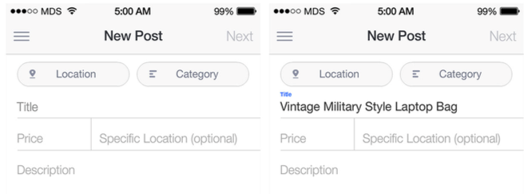
Notes:
1. With the Float Label pattern, watermarks become labels “floating” above the field once text is entered
Another option is to use hint text (i .e ., faint text prepopulated in the field that prompts users for the required info). But this can create a problem, because it disappears once the user starts entering text .
A distracted user can easily forget what she’s supposed to enter in that field. The Float Label is an emerging pattern that may address some of the usability problems around watermark labels . See more on this from Matt Smith, the pattern’s creator, at http://mattdsmith .com/ float-label-pattern/ .

Slide 19
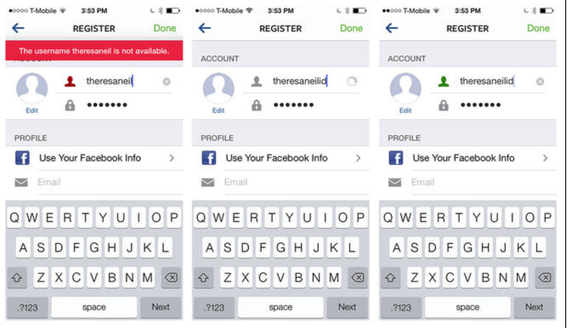
Notes:
2. Instagram for iOS: real- time inline feedback
Will you have certain requirements for password security, like upper- and lowercase letters and so forth? Tell users that before they tap the Submit or Done button, not in an error message afterward.

Slide 20
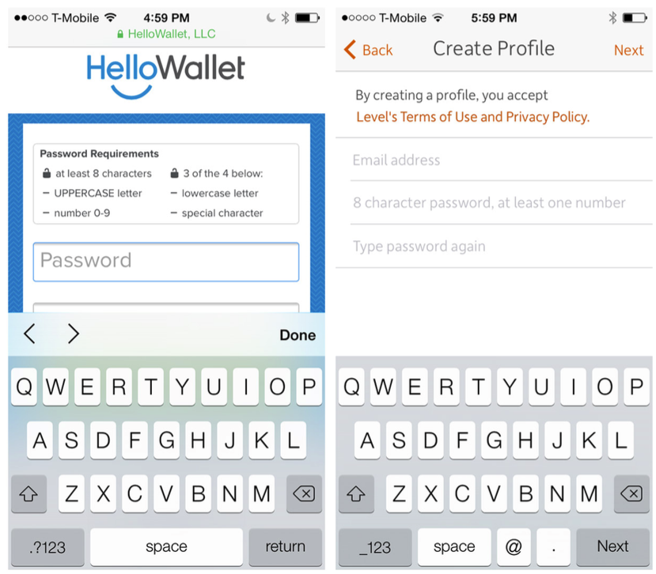
Notes:
Hello Wallet’s instructions are bit much; Level is more succinct (although it could improve its registration experience overall, in my opinion) .

Slide 21
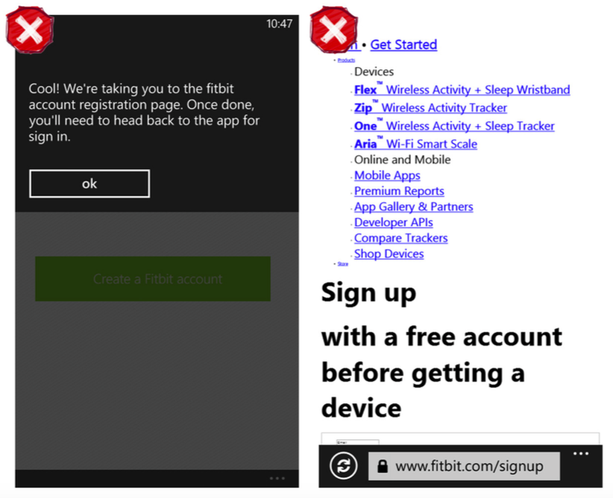
Notes:
Think of registration as a flow, and account for all possible user inputs . In another example from Level, I “accidentally” filled out the Registration form again, even though I already had an account . Even though there was a checkmark next to my email address—which would apparently indicate that it was acceptable—I received an error message because the email address was already in use . My only option was to tap “Bummer .”

Slide 22
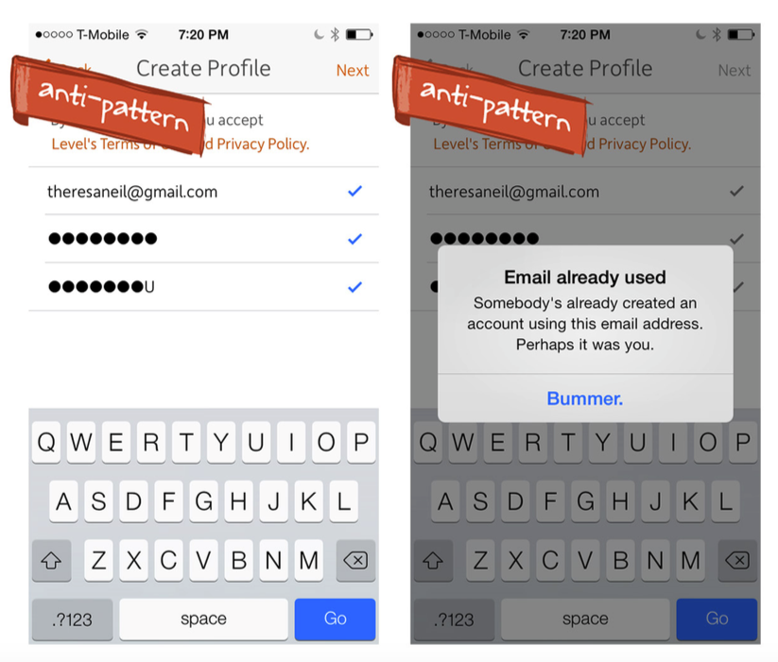
Notes:
Level for iOS: my email address has a checkmark by it, even though it’s already in use
Why not tell me the email address is already in use when I enter it in the form field? Or how about at least redirecting me to the Sign In screen with my email address prepopulated instead of serving me a lame error message that gives me no clue as to what step to take next?

Slide 23
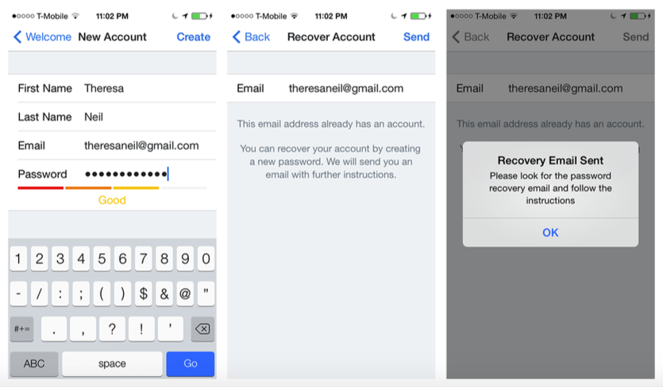
Notes:
Dropbox offers an elegant solution for this same scenario . Once it recognizes my email address it assumes that I would like to sign in, not reregister. Since I most likely need recovery instructions for my password, it prepopulates my email address on the recovery screen, so I only have to tap Send and I’m on my way.

Slide 24
Registration with Personalization
This is a relatively new pattern designed to either offer more personalized content to the user (as shown with Ness and News360), enhance the experience through social connections (Path and Instagram), or capture data required for setup (Personal Capital) .
The Multi-Step pattern we’ll look at next offers examples of more elaborate Registration flows .

Slide 25
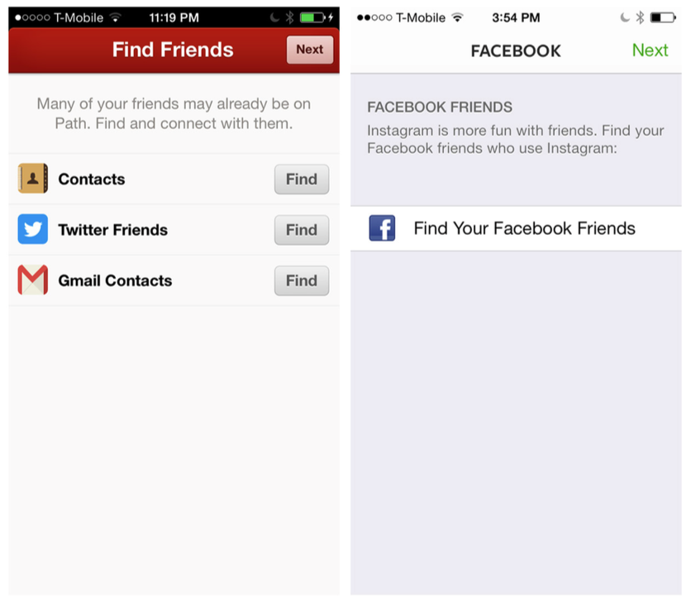
Notes:
Path and Instagram for iOS: encourage friend connections in the Registration flow

Slide 26
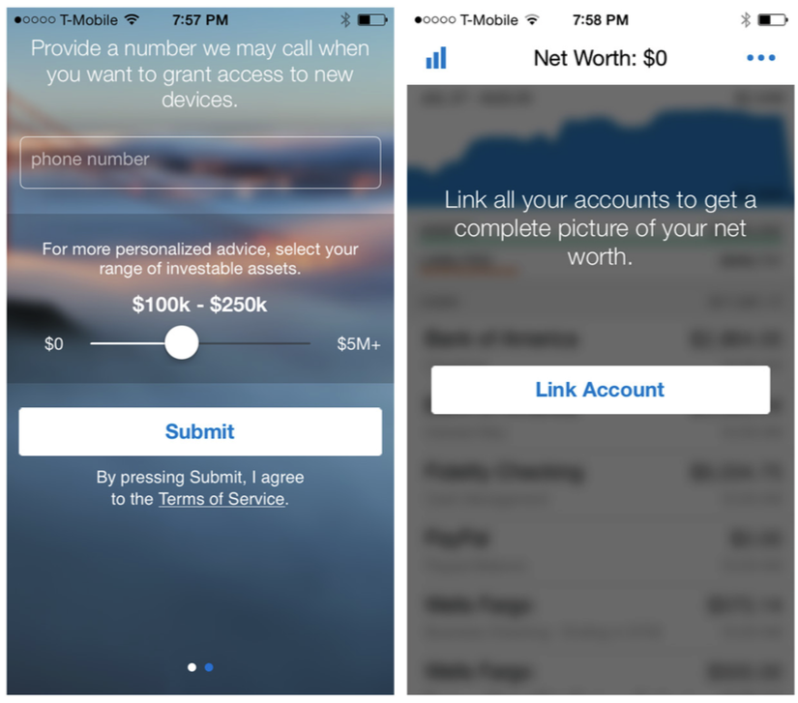
Notes:
Personal Capital for iOS: prompts for phone number and asset range and provides an opportunity to link accounts

Slide 27
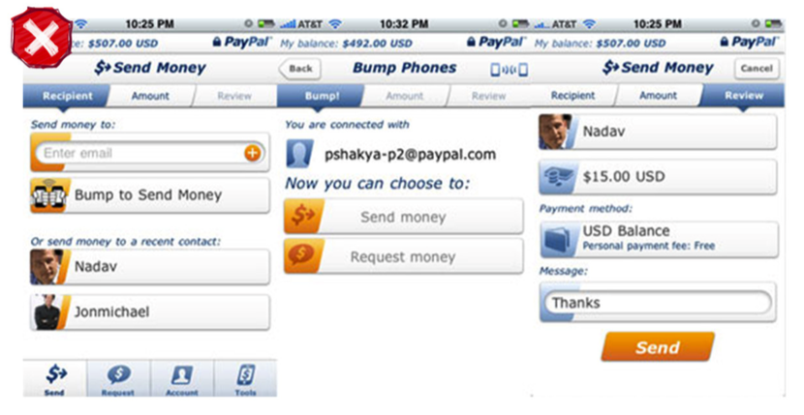
Notes:
Multi-Step
On the Web, Multi-Step registration processes often use process bars to show users where they are and what’s next . But with their smaller screens, mobile devices just don’t have the real estate to display bulky process bars . You might be able to cram one in the title bar, but there are better ways to guide mobile users through a series of steps .
For an early version of the PayPal iOS app, stakeholders insisted on a process bar . Sending money was a process, after all . But compare the 2010–2011 version with the current, much cleaner evolution .
PayPal for iOS, circa 2010–2011: Send Money process bar

Slide 28
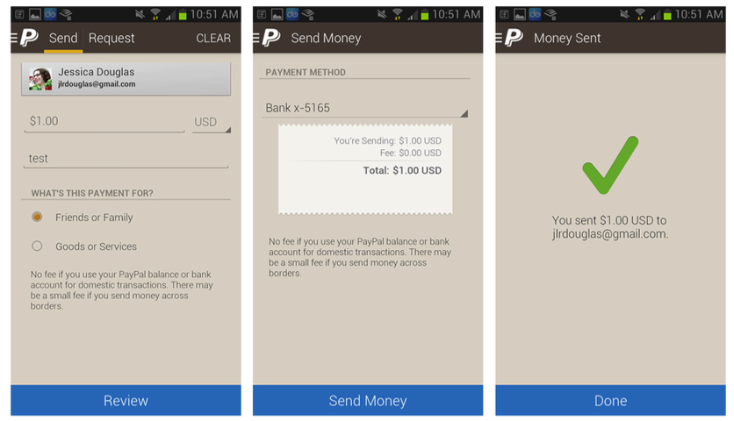
Notes:
PayPal circa 2013: losing the process bar is part of a cleaner overall look.
If steps have to be broken across multiple screens, skip the heavy process bar and consider displaying the current step among the total number of steps, like SnipSnap (displayed in the title bar) and Priceline (displayed in the footer) .

Slide 29
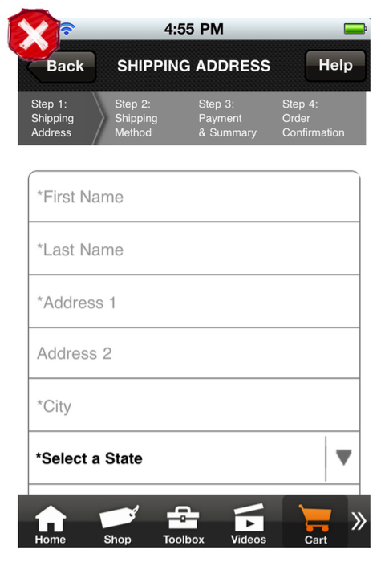
Notes:
home Depot for iOS (2011): overcrowded process bar
The secure checkout process first captures the delivery address . Upon tapping Next, you then select the delivery date . The delivery address is still shown, but in a read-only mode, with an Edit button .
Once the delivery date is selected, tapping Next reveals the payment form . Upon completing the payment form, you can review the total, and all of the information entered previously—while never leaving this screen—and proceed to the next step .

Slide 30
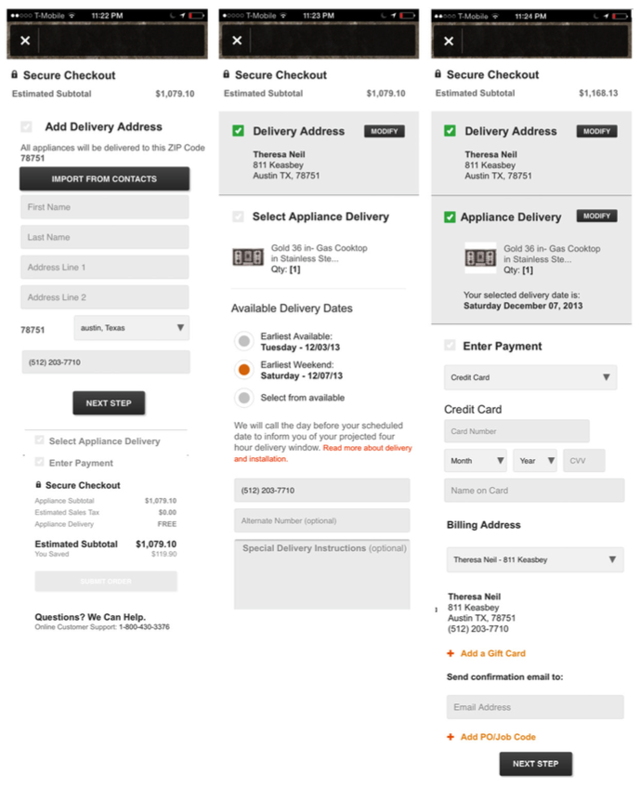
Notes:
home Depot for iOS (2013): much-improved checkout flow

Slide 31
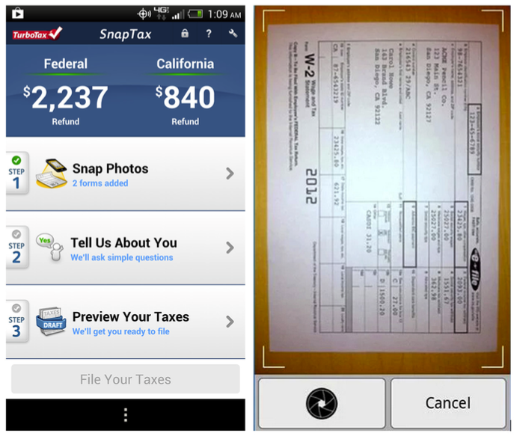
Notes:
TurboTax SnapTax uses a similar approach . However, the details for each step are collected in a drill-down screen instead of inline on the same screen. This single-page approach provides valuable navigation information (there are three steps in the process, two of which are remaining), and it also doubles as a high-level summary.

Slide 32
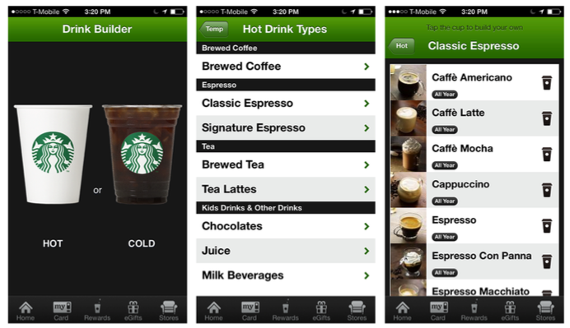
Notes:
Product configurators are a unique type of Multi-Step form that may need to allow for back-and-forth navigation, not just the typical linear flow . To enable this in its Drink Builder tool, Starbucks just uses Next- and Back-style buttons.
This works fine, but it is hard to see what’s been specified in the customization screens without opening every one of the options and scrolling through the list.
A simple fix could be a persistent Summary or Details button in the footer, near the Nutrition tab and Info icon. The Audi Configurator does exactly that, with a Details button that opens to reveal all of the selected preferences so far.

Slide 33
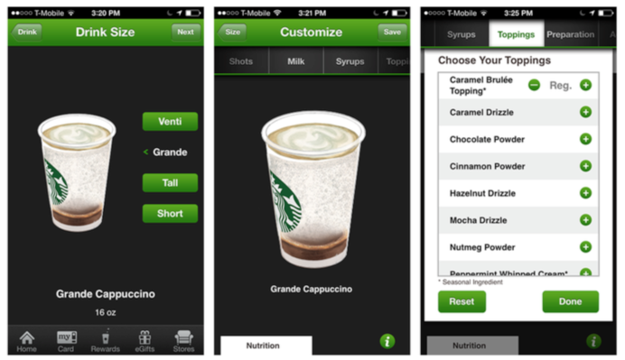

Slide 34
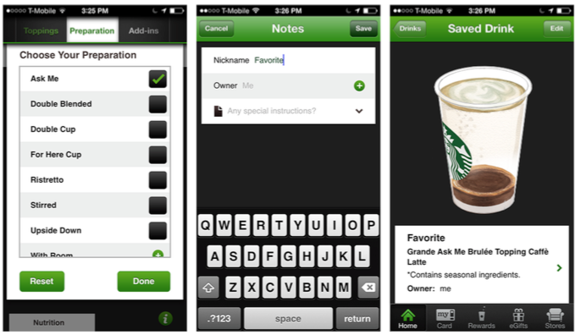

Slide 35
Checkout
As of January 2013, about 15% of ecommerce was being conducted via mobile devices, with the expectation that this will exceed 25% in a couple of years. However, even when the shopping experience starts on the phone, most people choose to finish the transaction, or checkout, via desktop or tablet or at the retailer.
In many cases, this is likely due to the incredibly bad checkout experiences many retailers include in their native apps. In others, it’s because many retailers only let users shop in their apps and redirect them to a mobile-optimized site for checkout .

Slide 36
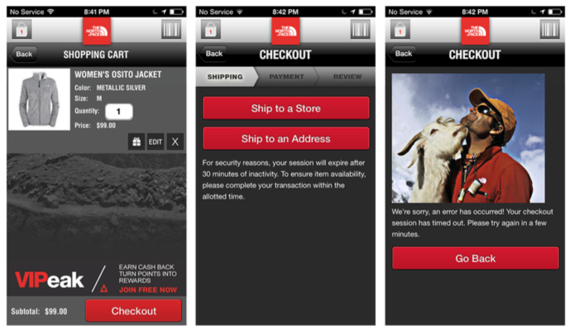
Notes:
The North Face for iOS times out when I try to check out—every time! Grr! Why have a timeout anyway?
Help your users buy right where they are, right when their interest is highest. Don’t let a poor UX deter your customers from checking out on their phones, preferably right within the app they are shopping from. Here are some design tips for creating a high-conversion checkout flow.

Slide 37
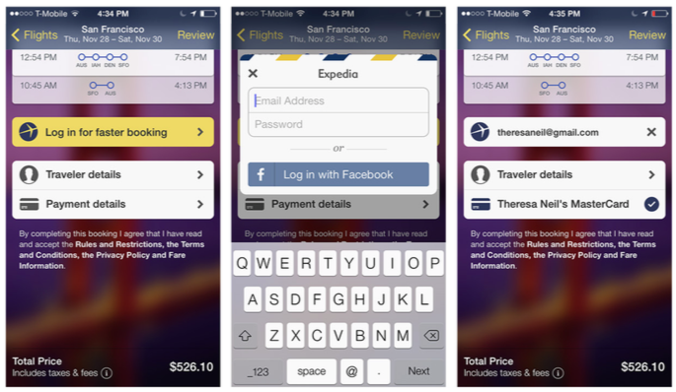
Tip #1: Include Sign In, Register, and Guest Options
Allow customers to save their account information with their profiles for faster checkout in the future, but also offer guest checkout. You can always prompt the user to create an account after checkout is complete, when he is more comfortable with the experience.
Notes:
Expedia for iOS: signing in prepopulates the checkout form with traveler and payment details

Slide 38
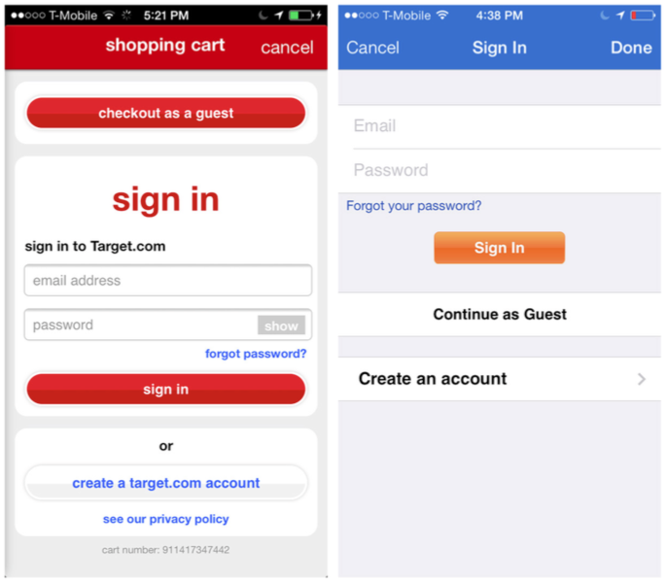
Notes:
Target and Walmart for iOS: offer guest checkout as well as Sign In/Register options

Slide 39
Tip #2: Streamline the Flow
Skip the process bar and consolidate multiple screens into one check- out page (see the earlier discussion of the Multi-Step pattern for a good example from Home Depot) .
Retailers like Haute and Apple present a single checkout form with sections users can drill down into to complete.

Slide 40
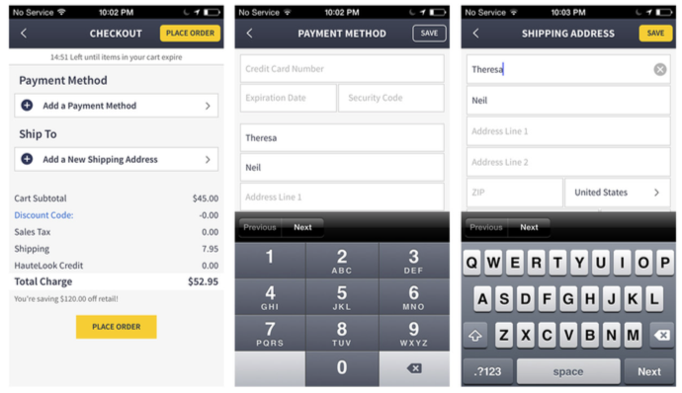
Notes:
Haute for iOS: single checkout screen with additional screens to add details

Slide 41
Tip #3: Provide Time-Saving Shortcuts
Offer an “Import Address from Contacts” option to quickly populate the user’s shipping and billing addresses. Also, consider a Scan Card feature to save the user the trouble of typing in all of her credit card info.

Slide 42
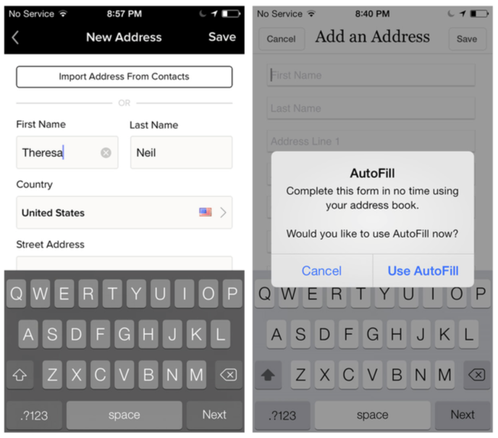
Notes:
Gilt and RuLaLa for iOS: optional import/autofill for entering addresses

Slide 43
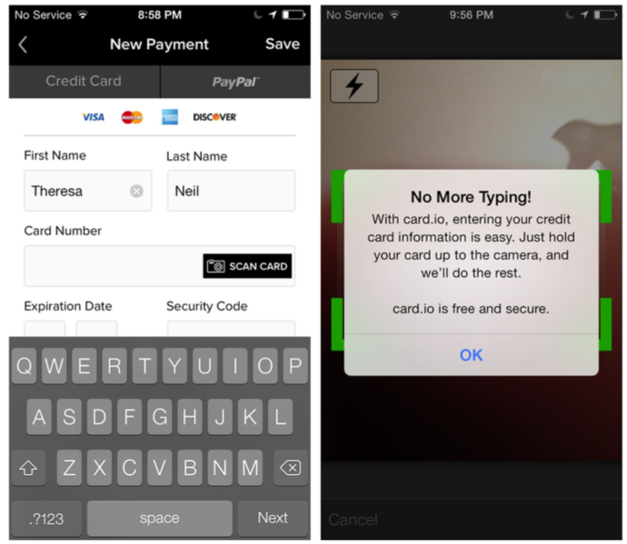
Notes:
Gilt for iOS: a Scan Card option via card.io

Slide 44
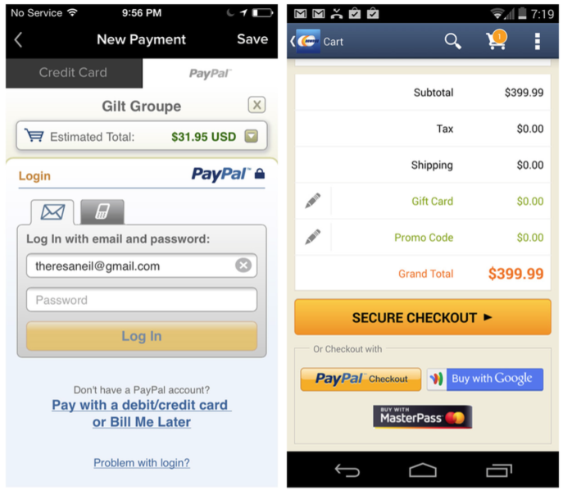

Slide 45
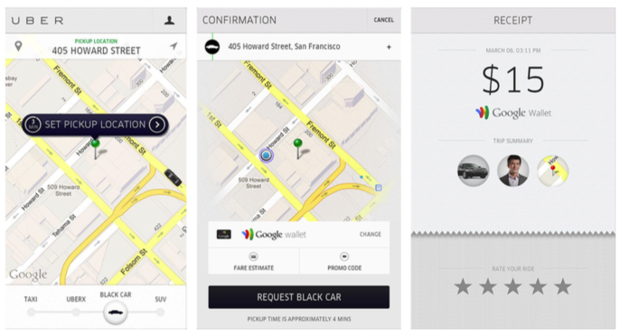
Notes:
Uber for iOS integrates Google Wallet to simplify booking a car

Slide 46
Tip #4: Offer Express Checkout
Consider offering an ultra-streamlined checkout process for registered users. The Apple Store prompts users with an option to set up Express Checkout. Amazon offers 1-Click checkout right on the product details page . In the example shown, there are two buttons for Mobile 1-Click, both in bright, call-to-action orange and sporting the 1-Click icon.

Slide 47
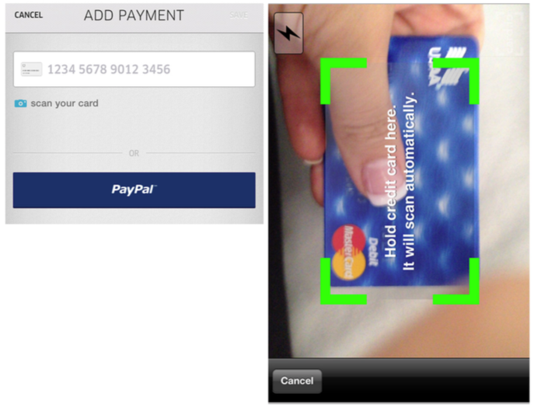
Notes:
Uber for iOS also offers credit card scan and PayPal options

Slide 48
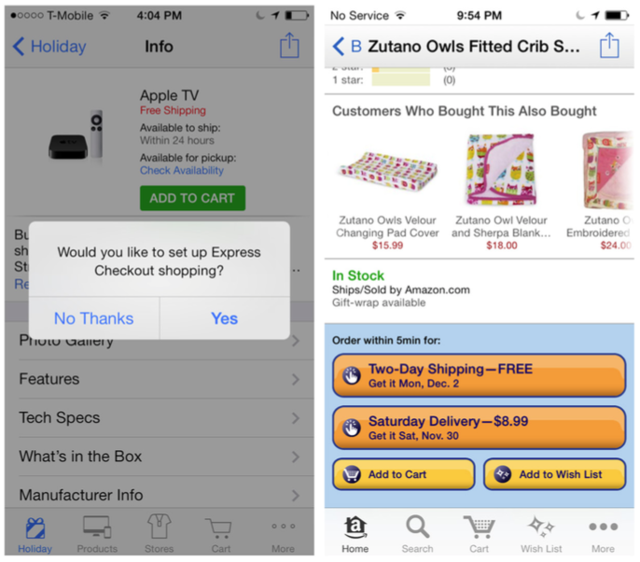
Notes:
Apple Store and Amazon for iOS: express checkout options

Slide 49
Tip #5: Forget the Web
Shopping on the Web has familiarized us all with the shopping cart metaphor and the multi-step checkout process, but the mobile retail space is ripe for innovation. Apple, Walmart, Target, and other retailers are experimenting with new checkout experiences both in and outside of the stores, with an eye to converting more sales on mobile.
Walmart’s Scan & Go feature, for instance, lets in-store customers skip the checkout line by scanning their own items as they add them to their shopping carts. Walmart reports that over half of all first-time users eventually use the feature again.

Slide 50
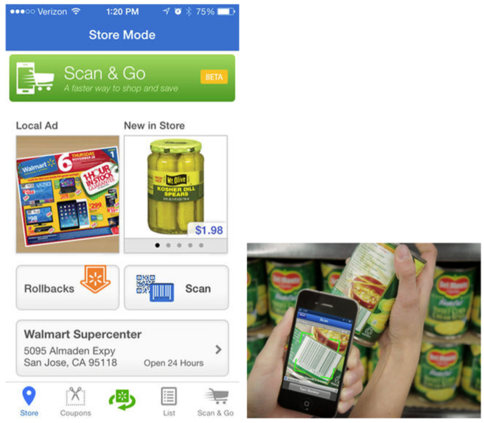
Notes:
Walmart for iOS: Scan & Go feature lets you skip the checkout line by scanning your own items
Design for mobile conversion by streamlining the checkout flow, eliminating unnecessary steps, and providing shortcuts. Look past web shopping conventions and take advantage of what native mobile technology can do.

Slide 51
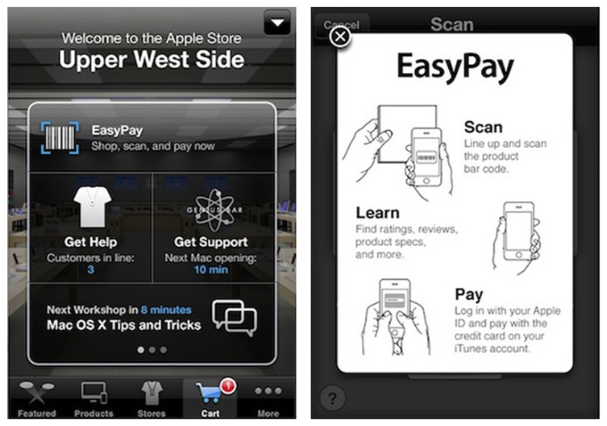
Notes:
The Apple Store includes the EasyPay self-checkout feature

Slide 52
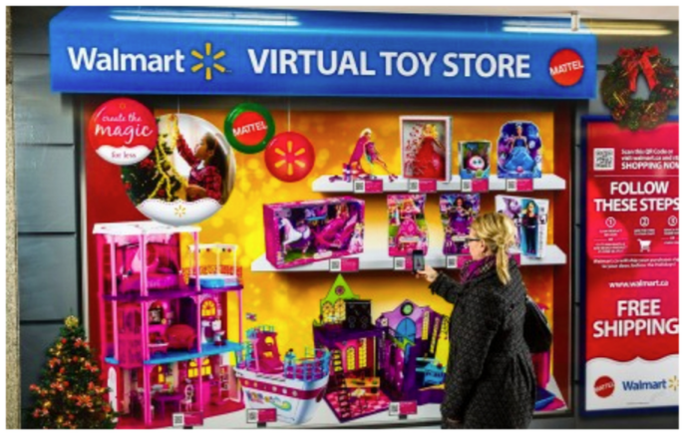
Notes:
Walmart Canada and Mattel’s virtual Toy Store (http://bit. ly/1g3f9Ld): scan a QR code to purchase an item

Slide 53
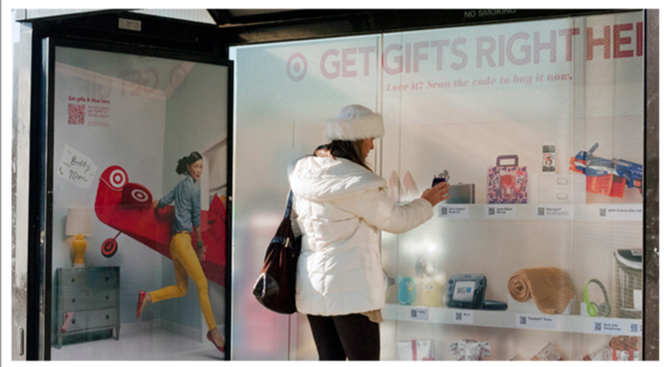
Notes:
Target and CBS Outdoors (http://bit. ly/1g3fi14): a bus stop becomes a “digital holiday experience”

Slide 54
Calculator Forms
Calculator-style apps, like weight trackers, tax estimators, and loan calculators, all require user input. And although these forms can accommodate custom controls and layouts, it is still important to follow basic conventions to make sure they are readable.
Alignment, labels, fonts, button placement, contrast, and colors all affect the usability of mobile forms. For example, compare the readability of the Valspar Paint Calculator, with its well-aligned fields and labels, with that of the Behr Paint Calculator.

Slide 55
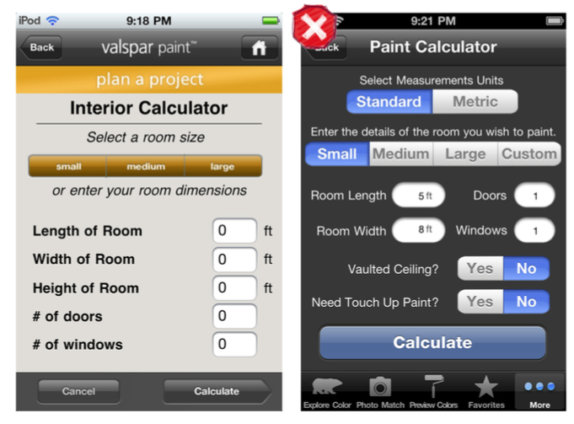
Notes:
The valspar Paint Calculator, with well- aligned fields, is easier to read than the Behr Paint Calculator

Slide 56
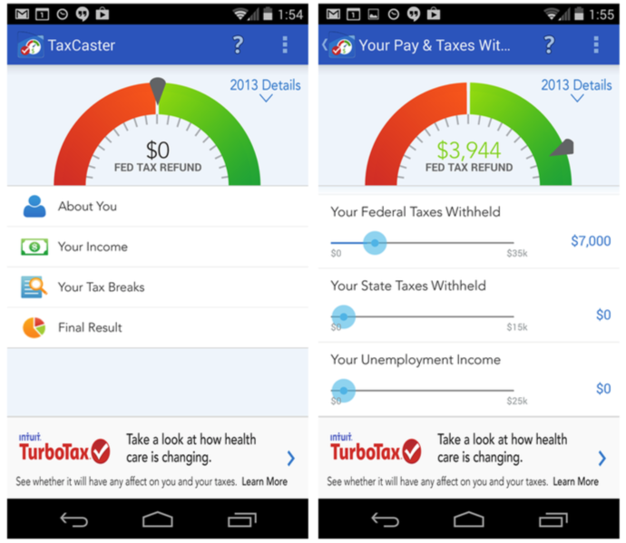
Notes:
The best calculation apps tightly correlate the input with a visual result. TaxCaster uses a gauge-style chart to visualize the amount of taxes due or to be refunded. The gauge updates as data is entered.

Slide 57
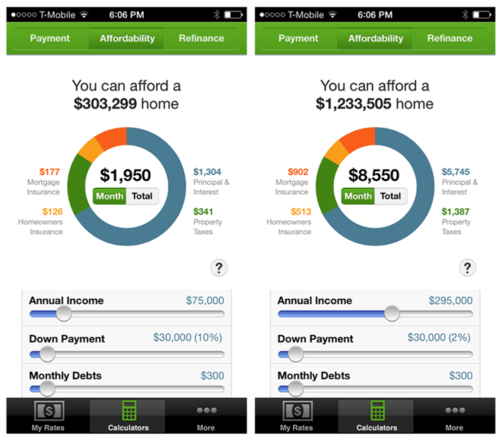
Notes:
The Zillow and Trulia Real Estate Calculators also provide a real-time view of data inputs .

Slide 58
Search Forms
Some searches require multiple inputs to generate results. Like the other form patterns, Search forms should have only the essential or most requested fields and provide sensible defaults. You can always offer a filter option on the results page to let people refine the results list.
Compare the confusing layout of the American Airlines Search form with the clean design in Kayak.

Slide 59
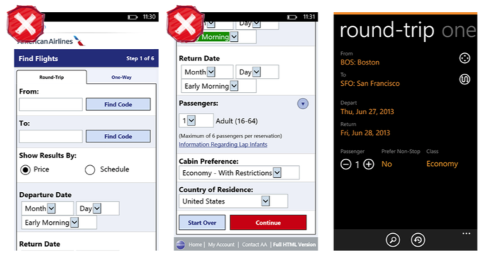
Notes:
American Airlines (2013) and Kayak for Windows Phone: clutter versus clean

Slide 60
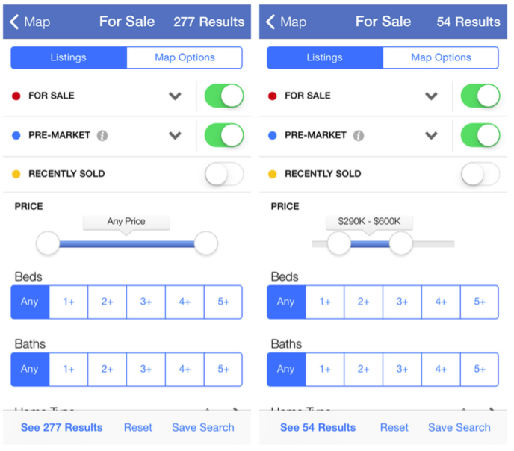
Notes:
Zillow for iOS displays the number of results as inputs are entered on the form

Slide 61

Notes:
OpenTable for iOS and Android (2011): user must enter all Search criteria

Slide 62

Notes:
OpenTable for iOS 7: Implicit Search autosuggests nearby options

Slide 63
Long Forms
Some forms can’t fit on a single screen . In these cases, a long scrolling page is vastly preferable to a form broken up across multiple pages.
The trickiest part of the Long Form is where to put the Command and Escape buttons.

Slide 64

Notes:
HauteLook, Square, and Lemon Wallet for iOS: Command button at top right
Don’t artificially break the form into multipage steps— scrolling on one page is preferable. But do ruthlessly edit any unnecessary fields. Follow OS standards for button placement.

Slide 65

Notes:
OLX and Innerfence for Windows Phone: Command button in App Bar
Windows Phone 8 design guidelines (http://bit .ly/1g3h4PM) suggest that the Command button should reside in the App Bar (which runs across the bottom of the screen) .
And, yes, Android has a completely different recommendation (http:// developer .android .com/design/patterns/actionbar.html) . Since the release of Jelly Bean (Android 4), Android’s design guidelines recommend that the Command button be located in the Action Bar (across the top) .

